Slide 1

Patterns of HE participation in London
March 4th 2016
Gary Tindell
Information Improvement Manager

Slide 2
Agenda
Background (Internal Research & External Collaborations)
Methodology
Report findings: The higher education journey of young London residents (July 2015)
Dissemination & Impacts
Questions

Slide 3
Longstanding Internal Research
First started analysing borough level HE data in 2002 to develop a strategy to align UEL programmes with emerging employment sectors
UEL used the data to internally for competitor analysis, identification of potential new markets for courses & areas for targeting WP outreach
Data repurposed to provide localised HE participation data and used as a KPI by CLG to justify capital spend on HE in the Thames Gateway

Slide 4
External Collaborations
Commissioned by the LBN to examine HE participation of local residents, particularly those educated at 16-19 outside the LA
The outcomes of the report were used to inform the business case for a £18 million investment in specialist sixth form centre
This collaboration was extended to all London Local Authorities as a result of a commission from London Councils

Slide 5
Methodology
Data procured from Higher Education Statistics Agency (HESA)
Analysis focuses on Young London-domiciled residents aged 18-24 years progressing to HE studying for a undergraduate degree on a full or part-time basis
Report examines the HE journey from pre-HE institutions, through their higher education study and onto their graduate employment destinations

Slide 6
Report findings: The higher education journey of young London residents (July 2015)
Overall progression to HE (London and by Local Authority)
Student Profile (Age, Gender & Ethnicity)
Entry Characteristics
HEIs by type and location

Slide 7
Young London residents progressing to HE (2007/8 – 2013/14)
Despite a small blip in 2010/11, evidence of steady growth in Young London residents progressing to HE, until the increase in tuition fees led to a 13% drop in 2012/13.
The following year saw a partial recovery of +7%

Slide 8
Young London residents progressing to HE - % year-on-year change
Some degree of turbulence within the sector making it difficult for HEIs to plan
Clear indication of the impact of the increase in tuition fees in 2012/13 followed by some partial recovery

Slide 9
Young London residents progressing to HE (Nos)
The increase in tuition fees in 2012/13 resulted in new students regressing to below 2007/08 levels
The following year saw new student numbers increase by over 4,300

Slide 10
Local Authority – Young residents progressing to HE – Time-Series
Clear signs of reduction in the numbers of Young people progressing to HE for every LA followed by increase in 2013/14

Slide 11
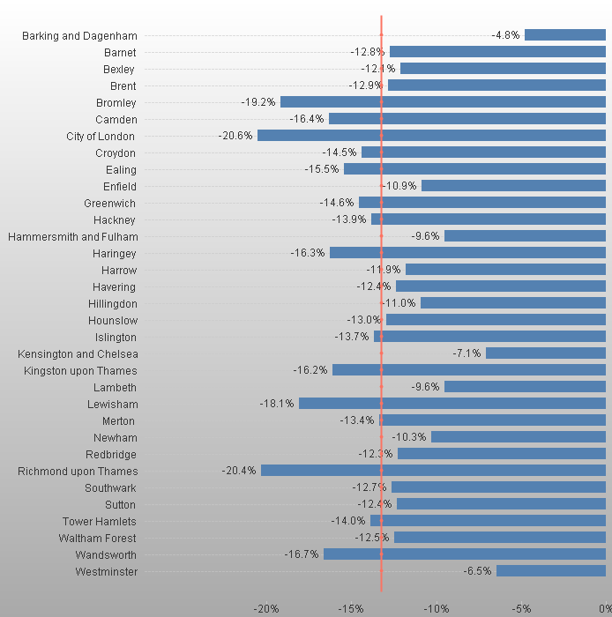
Local Authority – Increase in Tuition Fees – Annual Change
Rate of reduction by LA ranges from 5% to 20%, although most clustered around 12%-14%. Red line indicates the average reduction of 13.3%.

Slide 12
Local Authority – The year after the increase – Annual Change
Rate of increase by LA ranges from 1% to 15%, with two LAs experiencing a small reduction of 1% (Red line indicates the average increase of 7.3%).

Slide 13
Student Profile - Age on entry to HE
Evidence of recovery in the number of under 20 year olds progressing to HE, but no sign of a similar upturn for 21-24 year olds

Slide 14
Student Profile - Gender
The pattern is almost identical although there is evidence of a narrowing of the gender gap
Narrowing of the gender gap

Slide 15
Student Profile - Ethnicity
The largest reduction as a result of the tuition fee increase became apparent for young, white entrants to HE (-20%) although evidence of a 7% increase in the following year
Similar ethnic profile to London, although higher proportion of Indian students

Slide 16
Student Profile - Ethnicity Annual Change
Surprisingly, largest annual increase post-fee increase is evident within the young Bangladeshi communities

Slide 17
Entry to HE - Progression to HE by Type of Previous Inst
Despite a blip in 2012/13, the majority of young students originate from School Sixth Forms followed by FE Colleges

Slide 18
Entry to HE - Progression to HE by Type of Previous Inst: Annual Change
Largest increase amongst young students originating from school sixth forms with sixth form colleges not far behind. ‘Other’ largely comprises students educated at a overseas institution.

Slide 19
Entry to HE - Entry Qualifications (2013/14)
The majority of young students progress to HE with A/AS levels as their means of gaining entry

Slide 20
Entry to HE - Tariff Scores (2013/14)
Tariff scores starting to change form its bell-shaped distribution. However, their is evidence of significant reduction in those entering HE with the lower tariff scores (1-119).

Slide 21
Choice of HEI - Type of HEI
Almost 23% of young new entrants now progress to a Russell Group HEI. Although post-92s still remain the largest recruiter, the market share is declining from a peak of 49% in 2009/10 to below 45% in 2013/14.

Slide 22
Choice of HEI - Location of HEI (2013/14)
Tend to study relatively locally, mostly in London and the South-East. However, evidence of return to growth in English-based HEIs.

Slide 23
Choice of HEI - HEI attended (2013/14)
Wide range of HEIs attended, although not one dominant institution

Slide 24
Dissemination & Impacts
Regional report launched annually at seminar and disseminated widely across London
Accompanying mini-borough reports discussed at 14-19 LA groups
Presentation at Action on Access-UUK-OFFA-HEFCE conference (Feb 2014)
Regional report included as part of the supporting evidence for the HE Green paper Social Mobility Action Group

Slide 25
International Dissemination
  Invited presentation at joint City of Malmo/Malmo University Conference Sweden (May 2014)
  Resulted in City-University collaborative projects clustered around data and policy
  Study visit by colleagues from Malmo University (Dec 2014 & March 2015)
  Scheduled visit to London in October 2016 form senior staff at the University and City to share findings and good practice

Slide 26
Jisc/HESA HEIDI Lab Project
A new national analytics research and development project representing a first attempt at large scale cross institutional collaboration to create new BI dashboards
One of the projects is based on the collaborative model with London Councils but expanding this across the UK and integrating with other national datasets (Labour Market, Skills, Economic Infrastructure, IMD, POLAR3, School & College Performance, etc.)

Slide 27
Questions?

Slide 28
Contact Details
Gary Tindell
Information Improvement Manager
IT Services
University of East London
Email: g.c.tindell@uel.ac.uk
Tel: 0208 223 2065

