Slide 1
INVESTING IN A SUSTAINABLE FUTURE: THE ROLE OF TRADE UNIONS
Greenwich University
25th of May
Ronald Janssen
Senior Policy adviser to the Trade Union Advisory Committee to the OECD
janssen@tuac.org

Slide 2
SUMMARY RECAP OF THE ITUC PAPER
For eight emerging economies, a repeated annual increase of public spending by 1% of GDP over 5 years in the care sector, the green economy or in infrastructure ….
…. would increase GDP on average by 10 to 12 %
…. and employment by 6 to 12% on average
Positive spill-overs on productivity and from there on wages and working conditions
Partly self-financed, hence a role for (i) progressive fiscal policy and (ii) accommodating monetary policy (dual mandate with a higher weight for employment, band not point inflation targets) to fill the rest of the gap
Links up with international financial issues (debt cancellation, advanced economies leading the way to generate space on current account balances for emerging)

Slide 3
OUT-OF-THE ORDINARY NUMBERS ? NO!
OECD Economic Outlook: Estimates on necessary investment to manage climate change are huge
Revised (in course of euro crisis) estimates by IMF of fiscal multipliers show similarly high values (substantially above 1)
OECD Employment and Social Affairs research on the care sector

Slide 4
SUBSTANTIAL GAP WITH CURRENT ECONOMIC POLICY APPROACH
Quest against high inflation: Led by the Fed, an unprecedented and joint monetary policy cycle hiking interest rates across almost all advanced economies
Turn up the heat on emerging economies in particular :
Capital flight into US- dollars, currency depreciation making imports unaffordable (fertilizers for food!) and increasing burden and service of external debt
Forcing their central banks to tighten and stifle their economy as well
Providing the basis for a new round of fiscal tightening : Austerity 2.0

Slide 5
ECONOMIC NARRATIVE BEING REWRITTEN ONCE AGAIN
Financial crisis: A private sector led housing bubble collapse suddenly became the fault of public finances (Governments should have used the housing bubble to build enormous surpluses so they would have had the buffers when the bubble bursted… so the argument went at the time).
Cost-of-living crisis: A supply- side shock (temporarily) causing large shifts in relative prices pushing up overall inflation…..becomes being seen as an aggregate/across the board demand shock causing (recurrent) inflation

Slide 6
ROLE OF TRADE UNIONS
Trade unions empower workers by providing them with a “collective voice””
By bringing workers together, trade unions:
  Raise awareness of workers that many problems are not individual ones but shared by co-workers
  Increases worker understanding that collective solutions are necessary…and that by joining efforts, collective action to obtain these collective solutions cam ne undertaken
  In short: Trade unions open up collective understanding and the space to act and change things, either through collective bargaining (or collective action (strikes), in practice both
This is the case at the company level…
… but not only there, also at higher - national level, trade unions can and do act as a force for policy that benefit workers

Slide 7
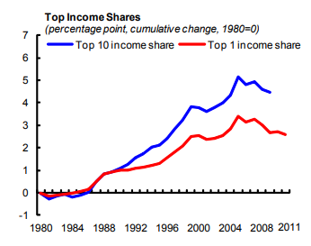
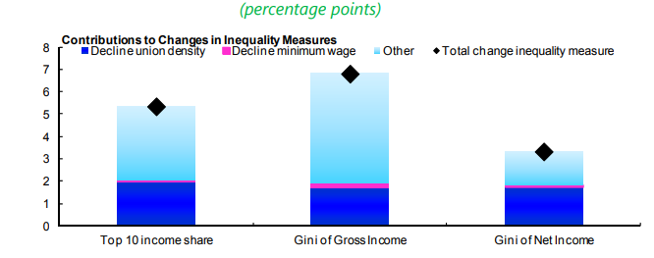
TRADE UNIONS AND WORKER VOICE LIMIT INQUALITY (IMF SDN 15/14)

Slide 8
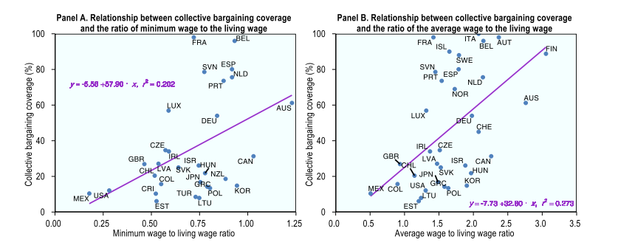
TRADE UNIONS AND WORKER VOICE WORK TO PROVIDE MORE DECENT LIVING WAGES (OECD Well Being and Inequalities WP April 2023)

Slide 9
COLLECTIVE BARGAINING REDUCES WORKING AGE POVERTY BY PROMOTING SOCIAL SPENDING (IZA DP 2021 145555)
Economies with coordinated/centralised collective bargaining have significantly lower working age poverty compared to countries with largely decentralised systems
Effect from coordinated/centralised bargaining on poverty = most noticeable when considering poverty after taxes and benefits
Points to role of trade unions using their political strength to promote public social spending and progressive taxes

Slide 10
QUESTIONING AND DEMANDING ALTERNATVES TO THE CURRENT ECONOMIC POLICY PARADIGM
Invest in structures of supply that are more secure and resilient (as opposed to austerity 2.0),
Selective price controls that prevent price gauging,
Promote social dialogue and collective bargaining empowering real wages to catch up while keeping central banks from putting growth and jobs at risk
More flexible price stability targets for central banks in the form of a target range (as opposed to single numerical points, the latter implying more less flexibility in monetary policy),
Tax excess profits to discourage corporate price gauging.

Slide 11
A QUOTE
“ “WITHOUT TRADE UNIONS, WORKERS HAVE NO VOICE. PERIOD.”
( William Spriggs, Chief Economist AFL-CIO)

