Slide 1

Join our wifi
eduroam is our wireless network for all our students. It's fast, free and available across all our campuses.
To access eduroam you must use your full username@gre.ac.uk login credentials, e.g. ab1234c@gre.ac.uk, plus your university password.
The geteduroam app is the easiest way to set up your mobile device to connect to the eduroam service. The app is available for iOS, Android 8 onwards, and Windows.

Slide 2
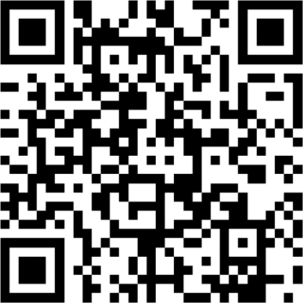
Check you can use a QR code
We know there is a strong link between actively engaging in your classes and succeeding in your studies, so we monitor attendance.
To make sure that we register your attendance accurately, we need you to share your location from your device.
This QR code will check that your location sharing configuration is correct.
Your location will only be shared at the point you register your attendance. Your location will not be shared at any other time.
Scan the QR code on the poster or browse to attend.gre.ac.uk/a.aspx
If prompted, sign in with your university username and password.
Press Allow to allow attend.gre.ac.uk to use your location.
If you see a page asking you to enter a registration code, your location settings are working, and you should be able to register attendance at your classes
If you see an ‘Error fetching location’ message, you will need to check your location settings. Search “attendance monitoring” in the Digital Student Centre or contact the IT Service Desk for further assistance.

