Slide 1


Friday 30th October 2015
International perspectives on policy, pedagogy and practice
in higher vocational education
University of Huddersfield,
School of Education and Professional Development
Gaps and bridges
from upper secondary vocational education (VET)
to higher vocational education – Danish experiences
Introduction: transitions to Higher Education in Denmark
What is the problem: blind alleys and bridges?
Why is it difficult to progress from VET to higher education?
Hybrid programme to improve progression
Christian Helms Jørgensen, Roskilde University, Denmark

Slide 2
Higher vocational education in Denmark
Education programmes in construction
Technical University
Technical University
University
college
University
college
Vocational
academy
Vocational
academy
Civil
Engineer in
construction
5 years
Diploma
Engineer in
construction
3,5 years
Vocational
school
Higher
vocational
education
Construction
Technician
2 years
AMU courses Few weeks
Vocational education
Apprenticeship based
12 main entrances
109 programmes
Upper
secondary
education
General education
‘classic’
Gymnasium
vocational
Gymnasium

Slide 3
Enrolment in higher education in Denmark has doubled
- What happened to VET and higher vocational education?
Higher vocational education - short cycle

Slide 4
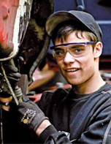
Vocational track

Slide 5

Share of a youth cohort entering the main programmes
of upper secondary education 1950 - 2005
An increasing
share of young
people attains
eligibility for
higher education
General track
Vocational track
The relative status
of VET decreases:
- a ’blind alley’

Slide 6
Tracking results in a social selection of students
according to the educational background of their parents

Slide 7
Transitions in the Danish educational system
Labour market
Master
Bachelor
Short
Higher
Vocational
Education
Short
Higher
Vocational
Education
Higher education
Vocational education
12 main entrances
109 programmes
Upper
secondary
education
General education
‘classic’
Gymnasium
vocational
Gymnasium
Vocational education
Apprenticeship based
12 main entrances
109 programmes
Basic school
9 – 10. grade
Widening the access to higher education and
limiting the enrolment and progression routes from VET

Slide 8
Since the 1970ies attempts to build bridges from VET to higher education
Policies for integration of general and vocational tracks in 1970s failed.
  Employers and unions allied to maintain their control of apprenticeship system.
  Tracking was maintained – and linkage measures added
Linkage policies from 1980s onwards were not successful:
  ‘Academization’ of higher education programs: increasing requirements for access to sub-Bachelor higher education
  The vocational gymnasiums from 1980ies have recruited the academically strong students who might have gone to the dual system of VET
  Very few have used the opportunities for taking additional study oriented subjects at higher levels in VET.
- so what is the results?

Slide 9
Percentages:
Shares of a youth cohort
Transitions in the Danish educational system
Labour market
Master
Bachelor
Vertical segmentation
Short
Higher
Vocational
Education
Higher education
HE enrolment
doubled from
24% in 1980
31%
VET: a blind alley on the road to HE?
61%
Only 6 % progress
to HE from VET
General education: Gymnasium
‘classic’ │ vocational
Gymnasium Gymnasiums
vocational education
12 main entrances
109 programmes
Basic school
9 – 10. grade
Final rates of completion 25 years after leaving basic school
Percentages of a youth cohort in 2013 Source UNI-C

Slide 10
Rates of progression from VET to HE until 5 years after graduation
Industry
VET: Child care
VET: Business/Retail
VET: Building
VET: Metal & Mechanical
VET: Media & Grafic
VET: Tech-Manufacture
VET: Social services
VET: Food & Restaurant
VET: Transport
VET: Health
Total
Total progression rate
Cohort 1991
(0)
4,5%
9,0%
6,3%
2,9%
12,3%
2,7%
4,5%
7,1%
2,6%
2918
7,7%
Cohort 1996
(0)
8,5%
7,1%
4,5%
4,6%
7,5%
3,7%
3,0%
3,8%
2,7%
3259
7,9%
Cohort 2001
12,6%
11,0%
4,8%
3,4%
2,4%
4,9%
2,7%
2,6%
2,2%
3,0%
3053
7,7%
Cohort 2006
3,2%
10,7%
3,0%
1,9%
3,3%
4,7%
2,0%
2,0%
4,8%
3,8%
2104
6,4%
Growth
Decline
Decline
Decline
Decline
Growth

Slide 11
Why this low rate of progression from Dual VET to higher education?
The dual system successfully transfers students out of the educational system and bring them into employment.
When VET students enter into employment they acquire good earnings and establish family – and have financial responsibilities .
Successful policies for vocational enhancement: Dual VET offer programmes at a high level EQF level 5 (e.g. data-technician 5½ years)
Limited wage differences: equal level of earning of skilled workers and graduates with Bachelor degree (nurses, teachers in basic school).

Slide 12
Why this low rate of progression from Dual VET to higher education?
The proportion of students in VET have relatively lower attainment (GPA) in basic school due to the ‘academic drift’ and activation policies.
Standardisation of the admission requirements for higher education programmes (Bologna process)
Competition for academic status of higher vocational institutions has restricted the recruitment from VET.
Skilled workers have had good opportunities for work based careers in the craft based production – supported by a comprehensive public system of vocational further training.

Slide 13
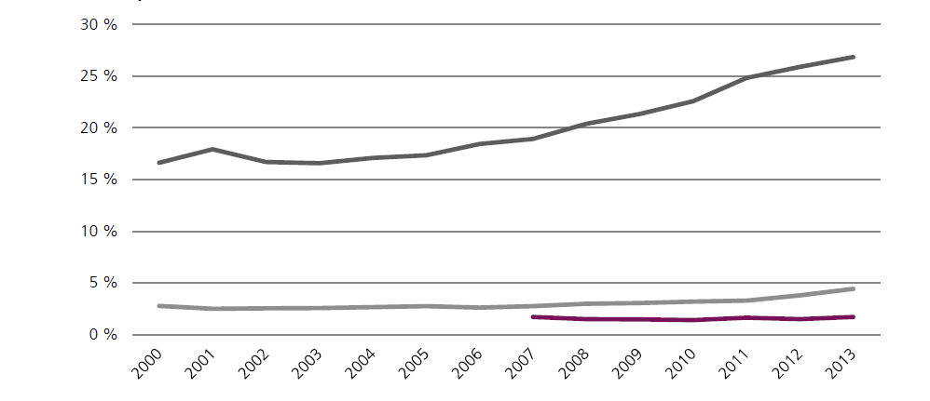
Proportion of students with high GPA levels 2000 – 2013 N = 58.925
Universities (Master)
Polarisation
stratification
University colleges (Bachelor)
Vocational Academies

Slide 14
Strengths of the dual system (modern apprenticeship)
  The transition to employment is integrated in the work based training
  Low youth unemployment and inclusion of non-academic youth
  High rates of employment on relevant level of skills
  Offers an alternative pathway besides - not below - the academic track.

Slide 15
  These advantages of apprenticeships are also weaknesses:
  Transfers students out of the educational system
  Diverts young people from higher education
  Appear as ‘blind alley’ in the educational system
  The social partners give priority to employability over HE eligibility
  This result in low permeability from dual VET to higher education
  Policy dilemma:
  → Trade-off between social inclusion in VET and social equality in access to higher education.
  → Difficult to achieve direct access to skilled employment and at the same time offer direct access to higher education from VET

Slide 16
Consequences of these weaknesses of vocational education in Denmark
Falling esteem : VET appear as a blind alley in the education system.
When choosing the dual system, they are diverted from higher education, and only 6% of a cohort progress from VET to higher education.
However, the large companies consider higher education graduates with a background in the dual system as attractive employees.
Political initiative for improving access from VET to higher education:
→ The eux programme was introduced to offer Hybrid Qualifications, that give access to skilled employment and higher education.

Slide 17
Position of the eux programme in the Danish educational system
Labour market
Master
Bachelor
Short
Higher
Vocational
Education
Higher education
61%
31%
General education: Gymnasium
‘classic’ │ vocational
Gymnasium Gymnasiums
E
u
x
Vocational education
12 main entrances
109 programmes
Basic school
9 – 10. grade

Slide 18
The new hybrid program eux in comparison with the existing programmes
1. year
2. year
3. year
4. year
The dual system
School
Work-place
School
Work-place
School
Workplace
School
Workplace
School
Workplace
School
Access to the labour market
Eux - the
new hybrid programme
School
Basic course
Workplace training
School
Workplace training
School
Workplace
Access to labour market and higher education
Technical Gymnasium
School
Basic course
School
1.year
School 2. year
School 3. year
Access to
higher education

Slide 19
Preliminary results of the new ‘bridge’ from VET to HE
  Has succeeded in obtaining high enrolment
  Very demanding programme: ‘two in one’ - in the time of one
  Difficult to include long work based training placements
  Might reduce the esteem of the ordinary VET programmes
        – contrary to the political intentions.

Slide 20
Presents results on hybrid qualifications
from 10 different countries

Slide 21
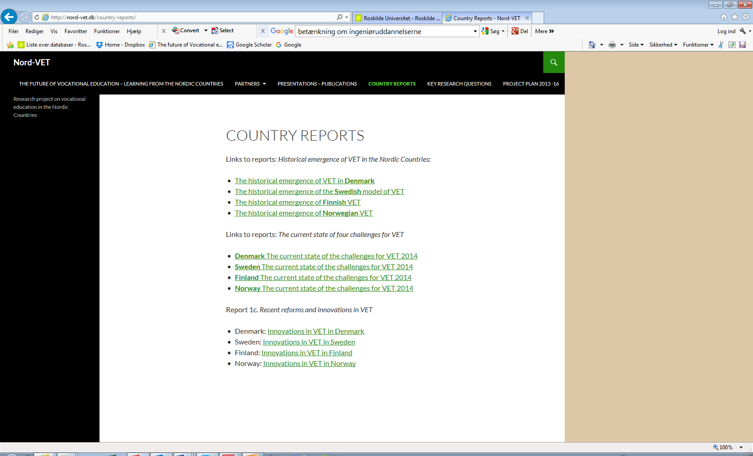
The future of Vocational education – learning from the Nordic countries
http://nord-vet.dk/
Thank you
for your attention !
For questions:
E-mail cjhj@ruc.dk

