Slide 1



ESRC SEMINAR SERIES 2014-2016
Higher Vocational Education and Pedagogy
HIVE PED
A Methodology for Tracking the Progression of Vocational Learners
Dr Suzie Dent - HESA
Sharon Smith - University of Greenwich
Centre for Leadership and Enterprise, Faculty of Education and Health

Slide 2
Longitudinal tracking of learners through Higher Education
Suzie Dent
Analytical Services Manager, HESA

Slide 3
Ad-hoc matching to HESA data
HESA cannot supply disclosive information (names, date of birth, postcode) but can match client data to HESA data using:
First names
Surname
Date of birth
Gender
Location information
  E.g. Postcode of domicile for UK students
  Geographic region of domicile or school

Slide 4
Matching preparation and cleaning
Separate names into first name, second name, third name and surname
Remove characters such as comma, apostrophe, hyphen and extra spaces
Convert names to upper case
Check for NULLS and unknown values
Check format and validation of dates
Check for spaces in postcode, remove additional or leading spaces and convert to upper case

Slide 5
Basic matching
Names | Surname | Postcode | DOB | Strength | Comment
Y | Y | Y | Y | Very | Should be a match
Y | N | Y | Y | Strong | Possible marriage or parents divorce
Y | Y | N | Y | Fairly | Strong when names are rare and distance between postcodes is small
N | Y | Y | Y | Fairly | Could be twins
Y | Y | Y | N | Weak | Unless birth dates are similar e.g. day and month swapped or typo
Y | N | N | Y | Weak | Unless names are rare and distance between postcodes is small
Y | N | Y | N | Weak | Strong when names are rare and birth dates are similar

Slide 6
Further considerations when matching
Names may be abbreviated e.g. Matt, Matthew
There may be spelling mistakes or different character sets e.g. Jørgen, Jorgen or Michael, Micheal
Contradicting middle names (less likely to be a match)
First and second names or surnames swapped
Rare names (more likely to be a match)
Double barrelled surnames
Postcodes may differ but be close together
Similar dates of birth e.g. 10/01/1992, 01/01/1992

Slide 7
Example statistics
Matthew Smith
DOB: 10 January 1992
Postcode: NR3 4QD
Match criteria | All records | Smith
Matthew | 24,500 | 290
Mathew | 1,000 | 15
Matt | 500 | 5
Mat | 10 | 0
Matilda | 350 | 5
10 January 1992 | 1,000 | 5
NR3 | 6,000 | 100
NR3 4QD | 10 | 0
Total | 2.9 million | 21,000

Slide 8
Matching example

Slide 9
Cleaning matched data
Add in missing links e.g. if A matches to C and D; B matches to C; then B should match to D.
Add a score to the matched data based on how good the match is between the pairs of fields
  Names match (first name, middle names, surname)
  Birthdate match or is close
  Postcode matches or distance between postcodes is low
  Gender match
  Frequency of name in data is low (first name or surname)
Remove duplicates based on best match and/or best progression (e.g. full-time first degree over part-time other undergraduate)

Slide 10
Combining matched data with HESA data
HESA student data may be combined with client data to form an anonymous dataset. For example, may include:
Person attributes (gender, ethnicity, age,…)
Entry information (qualifications held, domicile,…)
Course information (level, mode, subject,…)
Institution information (name, location, type,…)
Participation information (school type, participation neighbourhood, socio-economic classification)

Slide 11
Longitudinal matching
HESA data can be linked forward using student identifiers or more detailed to provide longitudinal information such as:
Continuation information
Qualification information : level, classification
Destination of leavers (six months after leaving)
  Activity (employment, further study, unemployed, other)
  Location of activity
  Average salary

Slide 12
NPD-ILR-HESA linked dataset
DfE link HESA data (2004/05 to 2011/12) to the Individual Learner Record (ILR) and National Pupil Database (NPD) to form linked NPD-ILR-HESA dataset
Linked dataset includes a subset of the HESA student data
Extracts from the linked dataset available on an ad-hoc basis
Available for research purposes only
Any requests including HESA data must be approved by HESA subject to data protection risk assessment
Additional information:
  http://www.hesa.ac.uk/content/view/2832/394/
  https://www.gov.uk/government/publications/national-pupil-database-user-guide-and-supporting-information

Slide 13
Analytical services: analytical.services@hesa.ac.uk
Tel: 01242 211115

Slide 14
Progression of Apprentices and
College leavers
to
Higher Education

Slide 15
Apprentice HE progression research
Importance of Vocational Progression Tracking Studies (Apprentices & London Level 3)
Contextual information
Key results
Notes:
Explain why this research was a) important b) new in the provision of new, up-to-date and in-depth knowledge
Remind ourselves that contextual information is key to understanding, we are interested in the progression of vocational learners; this is not a homogenous group of learners and context will help us to understand the common and varying patterns of HE progression
Briefly share some key results of the study to show the outcomes of undertaking a longitudinal data linking study

Slide 16
Why is the Apprentice Progression Tracking study important?
Progression through Apprentices, Skills Commission 2009
  “Very few former apprentices are currently progressing into advanced further education and higher education”.
  Quotes number of apprentices who applied through UCAS (excludes part-time entry)
  “Data on apprenticeship progression to these levels of learning is urgently needed if we are to give an increasing number of apprentices the best opportunity for progression and success”.
  “Recommendation 22: The Government should commission systematic research enabling it to monitor former apprentices who progress to higher education and advanced further education, and those former apprentices who have already progressed. A study should be built up year on year until the Unique Learner Number starts to produce informative data.”
Notes:
In 2009 the Skills Commission was asked to undertake an inquiry into progression routes into and through Apprentices, and made a series of policy recommendations.
The only data referred to in this study was UCAS applicant data – snapshot and of course excluded part-time entrants
There was a clear recommendation by the commission for systematic research

Slide 17
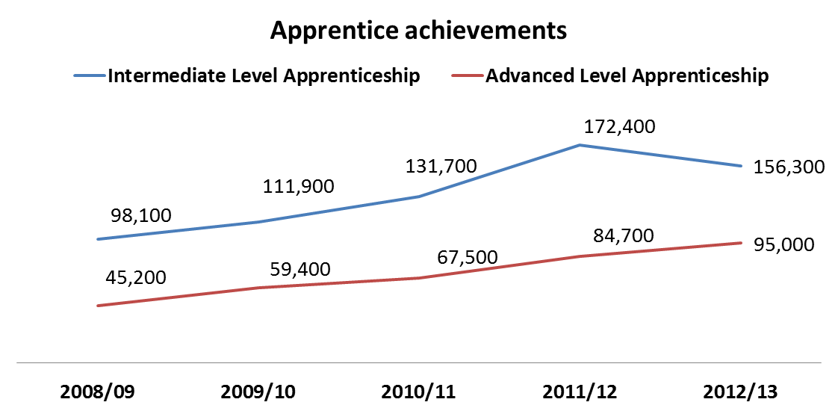
Why is the Apprentice Progression Tracking study important?
HEFCE, 2009 Apprentices, Pathways to Progression
  2002-03 to 2004-05 cohorts : 4% - 6% progression rate (one year after completion)
Changing landscape of apprentice provision
Notes:
Again in 2009, HEFCE produced a comprehensive report examining Apprentice progression but it was early cohorts and quoted an immediate progression rate of between 4%-6%.
Against a backdrop of huge increases in numbers of advanced apprentices in education, there was a clear need for research to understand the progression patterns of this ever expanding group of learners

Slide 18
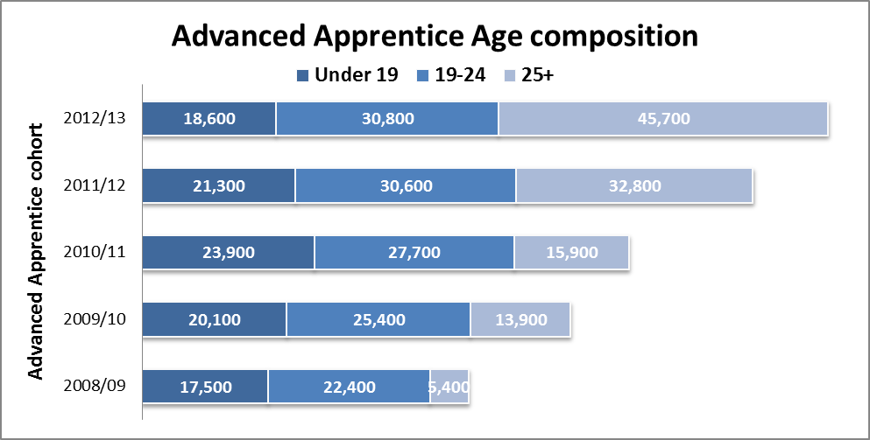
Why is the Apprentice Progression Tracking study important?
Changing landscape of apprentice provision
Notes:
The age composition of advanced apprentices has changed considerably as the chart shows. We need to consider the fact that the in 2008/09 age 19+ learners made up 61% of the population but by 2012/13 they account for 81%.
Other changes have occurred in HE for example, where there has been a rapid increase in the number of entrants with BTEC qualification and this has been driven particularly by the inclusion of BTEC on UCAS tariff – opening doors

Slide 19
Advanced Apprentices
Roll on, roll off nature of apprentice study
Prior qualifications on entry
Different framework structures .e.g duration, components
Growth in particular frameworks (females, 25+)
Notes:
Context is key to understanding this complex group of vocational learners Advanced apprentices have qualities that differentiate them from other groups of learners, for example:
No academic years, they roll on to their apprentice, undertake their study components at different times and as such an apprentice will be recorded on the ILR many times and across a number of years
Some apprentices may already have HE experience (3%) and this group of learners has been increased with the expansion in older learners on an apprentice framework
Apprentice frameworks are quite different in their composition. An Engineering framework might take 2-3 years to complete whilst a Business Administration framework only 1-2 years. Some frameworks are made up of Key Skills, BTEC and an NVQ whilst others e.g Accountancy framework is only comprised of the Diploma in Accounting

Slide 20

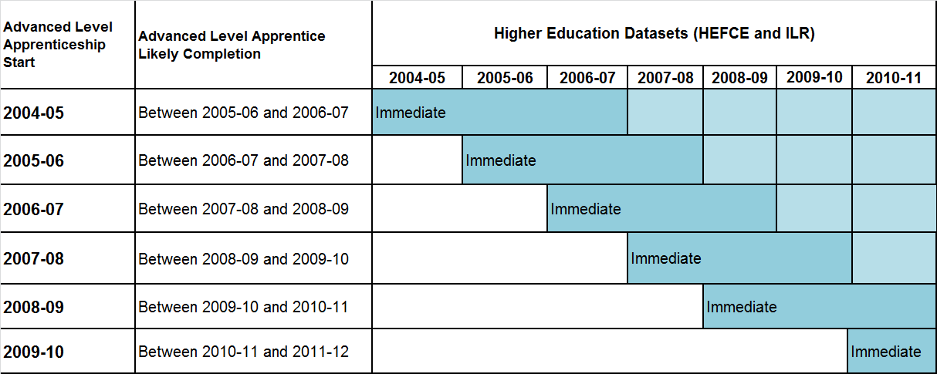
Progression of Apprentices to Higher Education
March 2013, 2004-2008 cohort
March 2014 (TBA), 2005-2011 cohort
Notes:
Move onto the HE progression study undertaken by Greenwich on behalf of BIS
First study tracked 5 cohorts of learners 2004 – 2008 through to HESA datasets 2004-2010
Second study tracked 5 cohorts of learners 2005- 2009 through to HESA datasets 2005-2011
This study differs from other progression studies in that we use the start year of the apprentice to define cohorts. This was to reflect the roll on roll off nature of the apprentice and working closely with HEFCE we decided that this was the most reliable way of investigating progression patterns. HESA tracking had identified that when we used end year, we could see that some students had entered HE before their apprenticeship “ended”

Slide 21
Progression of Apprentices to Higher Education
Identify progression through to HE from Level 2
Identify those learners who had already been in HE
Progression rates and timing of progression
Compare progression to non-prescribed HE and prescribed HE
Breakdown progression to HE in FE and University
Compare progression rates by framework
Identify variations in regional progression rates
Analyse the disadvantaged profile of apprentices
Identify HE institutions progressed to
Notes:
The longitudinal tracking at individual student level has enabled us to undertake a in-depth inquiry to progression as this slide shows.
For the first time we were able to see the extent to which our cohort already had an HE qualification and
Timing of entry
Also able to examine progression by delivery rather than just funding

Slide 22


Advanced Apprentice Vignettes
Started a degree in Creative Arts but did not complete
Entered employment
Health & Social Care Advanced Apprentice
Accountancy Advanced Level Apprentice
Already had a Biology First Degree before starting their Apprentice
Notes:
These vignettes help to highlight the stories contained with the datasets and remind us of the complex nature of vocational learner progression

Slide 23
Advanced Apprentice tracked cohort – changing composition
2004-05
1% - aged 25 years+
39% females
2009-10
24% - aged 25 years+
52% females
4% BME
10% BME
7% Business Administration
12% Business Administration
Notes:
This slides examines the tracked cohort and how this has changed over the first cohort year and the last cohort year. This changing composition helps to explain our findings and how trends show varying patterns
The slide only gives some characteristics but the study includes many other learner attributes such as domicile and backround

Slide 24
Advanced Apprentice –
HE progression (immediate)
2004-05
10.4% to HE
(15.4% 7 years)
12.3% to HE
17-19 years
2008-09
8.1% to HE
12.4% to HE
17-19 years
5% to HE
London domiciles
8% to HE
London domiciles
11% of HE entrants to
First Degree
18% of HE entrants to
First Degree
Notes:
A few key results presented in this slide and these are updated in the latest study which will published soon but show a dynamic pattern of progression for advanced apprentices against the backdrop we discussed earlier.
The 2004-05 rates quoted, 10.4% up to 15.4% when tracked for 7 years show the importance of longitudinal learners where learners are coming into HE some time later after their apprenticeship
The decrease in HE rate observed across the cohorts is influenced greatly by the huge increase in older Adv Apprentices aged 25+ who are not entering HE at the same rate as younger learners
There are regional differences highlighted. London with the lowest pop of Adv App has seen an increase in HE progression rates while other areas have seen a decline.
Also seen a growth in % of adv app HE entrants who are coming into First Degree programmes rather than HND/Foundation degree.

Slide 25
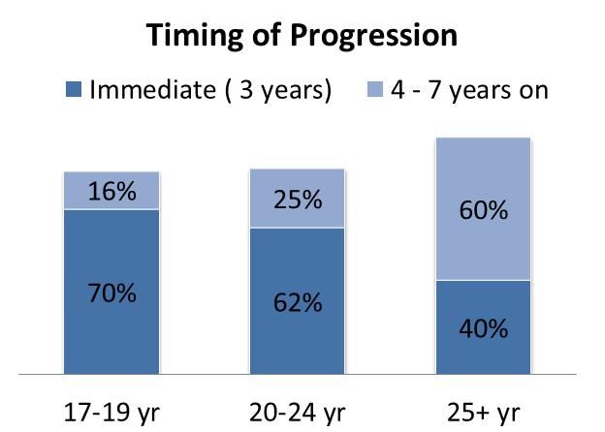
Advanced Apprentice HE progression results
An immediate progression rate of 10.4% increasing to 15.4% when tracked over 7 years but with differences by age group

Slide 26
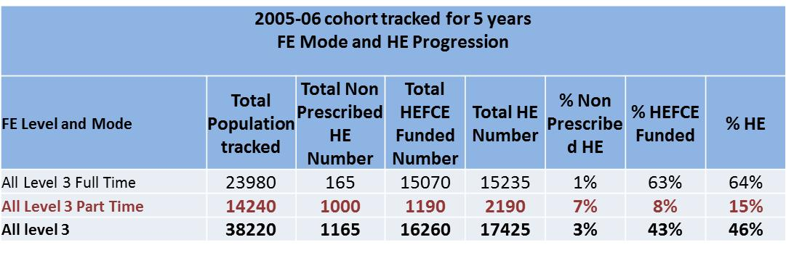
London Level 3 HE progression study
Includes part-time vocational level 3 learners:
e.g. Advanced Certificate in Counselling; Award in Computer Hardware; Certificate for Health Trainers; Certificate in Customer Service; Certificate in Supporting Youth Work; Diploma in Human Resources Practice

Slide 27
London Level 3 HE progression study
FE Qualification Type | FE Level 3 Cohort year - % HE Progression Rate, (tracked to HE for one year) |  |  |  |  | % point change 2005-2009
 | 2005-06 | 2006-07 | 2007-08 | 2008-09 | 2009-10
Access to HE | 56.8% | 54.9% | 53.2% | 50.6% | 49.5% | -7.3%
GCE A2 Level/IB | 70.4% | 66.8% | 68.6% | 67.8% | 65.0% | -5.4%
GCE AS Level | 13.8% | 11.5% | 9.9% | 9.2% | 6.6% | -7.2%
BTEC (Full Time) | 44.2% | 45.6% | 48.1% | 49.5% | 47.3% | 3.1%
NVQ | 17.8% | 15.8% | 11.3% | 7.7% | 7.3% | -10.5%
Other Vocational Full-time | 48.0% | 28.5% | 25.2% | 23.9% | 22.5% | -25.4%
Other Vocational Part-time | 7.1% | 7.7% | 6.5% | 6.8% | 7.0% | -0.1%
All Level 3 | 34.9% | 33.7% | 33.6% | 32.4% | 30.5% | -4.4%

Slide 28
London Level 3 HE progression study
2005-06 Level 3 who progressed to HE:
Mode and HE qualification

Slide 29
What next?
Continuing with data research series –
  The learning records service
Further qualitative research
Cross-sectoral evidence based practice
Notes:
So, what next?
The FE and HE sector is still under a period of considerable change – introduction of HE fees in 2012, changes in funding for mature learners e.g. part-time loans
Still in imperative to continue with data research. We can make this research easier with the UPN and being able to track students longitudinally through one united dataset but although pilots have been underway with this project we are still waiting for a full implementation.
Data research can generate more lines of inquiry some of which can only be explored through qualitative research, not only investigating apprentice attitudes but providers too, and employers
Lastly, important that we make good use of the research ask ourselves how we can encourage the sectors to use it to inform practice. Not only use it independently within sectors but collaboratively, across sectors to continue to smooth pathways for this group of learners.

