Slide 1


How middle attainers in 14-19 education are being overlooked and squeezed by policy: a London focus
Ann Hodgson and Ken Spours
Centre for Post-14 Education and Work
UCL Institute of Education

Slide 2
The problem
London has a post-16 problem - relatively poor educational performance compared with pre-16 and difficult transitions to the labour market
The post-16 problem is first highlighted at the 17+ transition with high drop-out rates and low volumes of study

Slide 3
London and 14+ progression
  Wealthy, dynamic but polarised socially, economically and educationally
    Variability within and between the Boroughs at KS4 and beyond
    High levels of participation in school sixth forms at 16+
    High drop out or churn at 17+
    Low levels of apprenticeships compared nationally
    Delayed access to labour market
  The ’middle attainer’ is becoming at risk post-16 due to the institutional arrangements in London and the impact of policy

Slide 4
Policy and the Missing Middle
A neglected category of young people in England located between high attainers in A Levels and NEETs/Apprentices
Focus of policy
EBacc attainment 24%
AAB A Level by 18 17%
3 A*A grade A Levels 10%
AAB in a facilitating subject 9%
Missing Middle
‘Marginal’ A Level learners 20.0%
Vocational L3 14.6%
Vocational L2 13.2%
Vocational L1 6.0%
Total 53.8%

Slide 5
London and 17+ issue
High levels of participation compared nationally – 3-5% higher at 16 and 17
But a quarter of Level 3 starters ‘dropped out’ at 17+
17+ retention in A Levels in schools (82%) compared with Level 3 vocational courses (59%)
London below national average on Level 3 attainment, particularly Total A Level Points – 682 compared to 706 nationally
  About 30% of Level 3 learners in London schools in 2011/12 did not have A*-C grades in GCSE E&M and scored on average 540 points
  Those who had at least 5 GCSE A*-C grades including E&M scored on average 753 points
  Those with 8+ GCSE A*-C grades including E&M scored on average 795 points

Slide 6
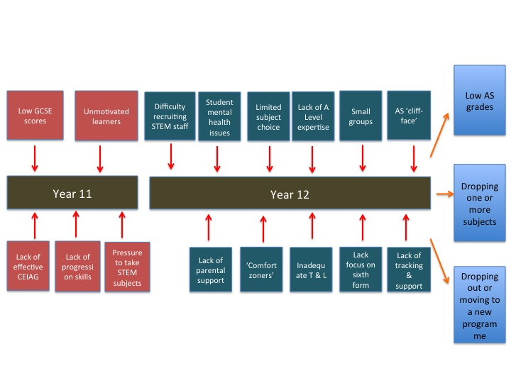
17+ risk factors – London schools

Slide 7
Performance and skills equilibrium - the new stagnation?
14+ performance & transitions problems
Chronically small work-based route (low apprenticeship starts and poor labour market transitions)
Qualifications reform and greater selection (EBacc, GCSE, A Levels & Voc Quals)
School selection (problems of CEIAG, effective provision and decanting the middle attainer)
Area Reviews and funding cuts to FE (less provision, longer journeys to learn, merger disruption)

