Slide 1
From the doom loop to a (global) economy for work not wealth
Geoff Tily, TUC

Slide 2
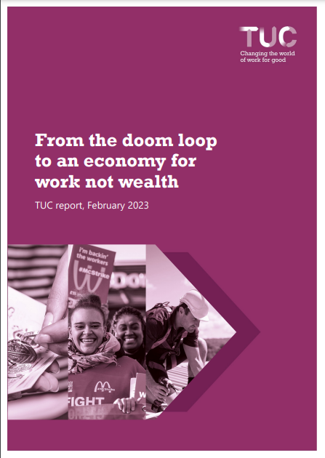
Outline
Diagnosis / theory
Results
  1945-1979 versus 1979-present
Internationalism and power: past and present

Slide 3
“a system which robs the nation of its wealth, acts as a drag on industry, and cheats labour of its own”,
Keir Hardie, 1907.
Amount and quality of output and employment
Absolute under-production / deficient supply
Relative over-production / excess supply
Setting of economy
Wealth
Labour

Slide 4

1. Diagnosis: from power to deficient demand …
…conflict mainly between bankers and owners of financial wealth on one side and ordinary households on the other – between the very rich and everyone else.
The underlying problem was an economic and political system that “placed large surplus savings in the hands of a plutocracy”. Income concentration gave the rich “an excess of consuming power that they cannot use” at the expense if everyone else.

Slide 5
… and excessive private (corporate and household) debt
Across the world, the rich have prospered while workers can no longer afford to buy what they produce … or have been forced into higher levels of debt.

Slide 6
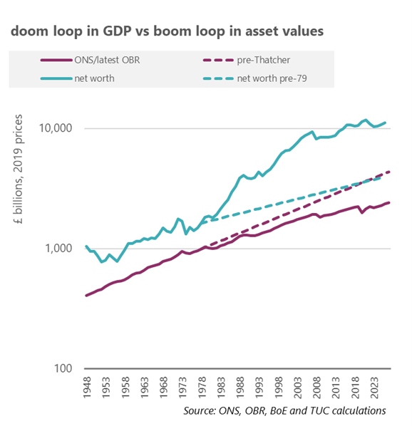
2. Results: Doom loop in GDP v boom loop in wealth

Slide 7
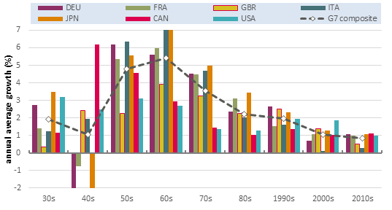
2. Results: Orthodox /supply narrative
the root of Britain’s industrial problem was low productivity. Thatcher
The context for Britain in the 2020s is a country … struck by the interlinked challenges of weak productivity growth and stagnating living standards, Resolution Foundation (2022)

Slide 8
3. Internationalism: past and present. Rebalance power through changed economic relations between nations.
If nations can learn to provide themselves with full employment by their domestic policy … there need be no important economic forces calculated to set the interest of one country against that of its neighbours …
J. M. Keynes, The General Theory of Employment, Interest and Money, 1936
It is recognised at last that the expansion of international trade depends on the maintenance of Full Employment – and not the other way round … i.e. a solid foundation on which we could build a positive international full employment policy. This, in my view, transcends in importance all else.
Hugh Gaitskell, The Daily Herald, 1945 (cited in Williams, 1979, p. 217)

Slide 9
“a system which robs the nation of its wealth, acts as a drag on industry, and cheats labour of its own”,
Keir Hardie, 1907.
Amount and quality of output and employment
Absolute under-production / deficient supply
Relative over-production / excess supply
Setting of economy
Wealth
Labour

Slide 10

“Growing inequalities putting us on a trajectory to implosion”
Rich Trumka,
28 May 2021.

Slide 11
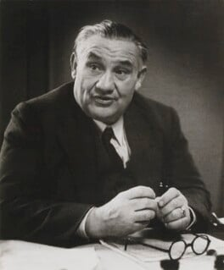
An internationalism of labour
In short, international policy should be based not on the increase and safeguarding of the total trade and income of individual countries, but on the provision by international cooperation of the needs of human individuals … Britishers, Poles, Chileans, etc. being looked at together as human beings whose well-being is interdependent. (Bevin, late 1940)

Slide 12
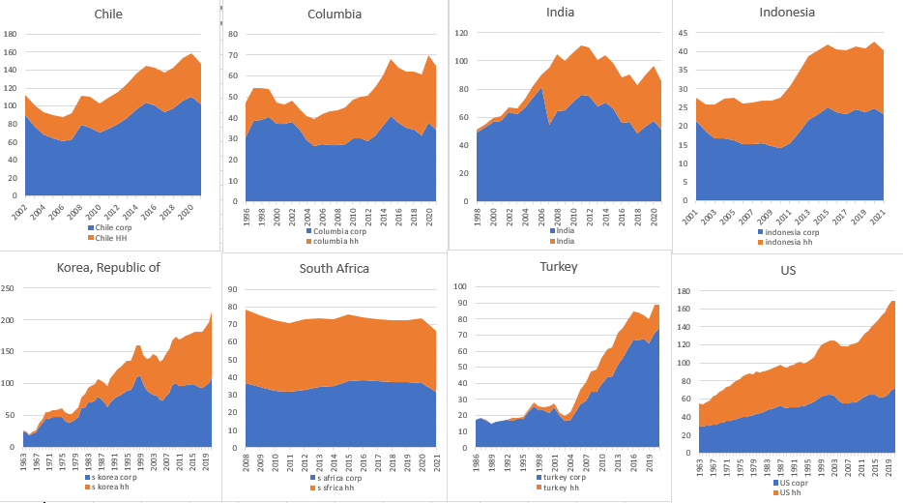
Corporate (blue) and household debt (orange) as %GDP

Slide 13
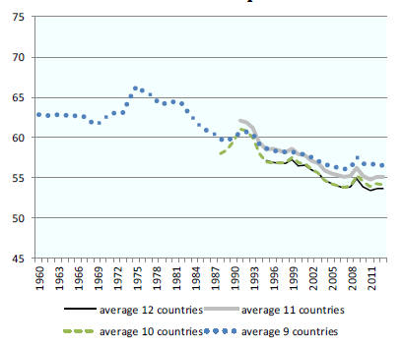
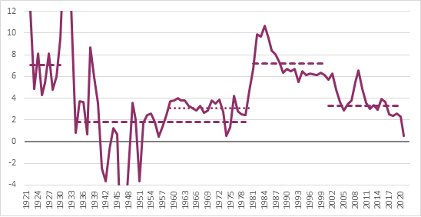
1. Diagnosis: power/demand analysis
US real rate of interest
G20 labour share

