Slide 1






University of Greenwich Faculty of Education and Health
Friday 6th March 2015
ESRC HIVE-PED
Research Seminar Series
Professor Jill Jameson
Professor of Education , University of Greenwich
Director, Centre for Leadership and Enterprise
Professor of Education , University of Greenwich
Notes:
1

Slide 2

Seminar Four
Crafty work: re-forming, re-making & re-thinking vocational & technical education 2010-15
Friday 6 March 2015 University of Greenwich 11.00 – 3.00
Devonport House, King William Walk, Greenwich, London, SE10 9JW

Slide 3
ESRC Research Series Vision:
'HIVE-PED: Higher Vocational Education and Pedagogy in England 2013-16’
* nine expert research seminars/ events
* three overarching research themes
* parity, progression and social mobility

Slide 4
Series sub-themes
* Parity, vocational pedagogy, leadership
* Democratic citizenship
* Progression into HE, social mobility
* Professionalism, HIVE qualifications
* Changing the training culture
* Student success in and beyond HE
* Motivation, trust and drop-out

Slide 5
Contextual factors:
* election, roles FE, HE, employers, govt
* challenges ££ cuts, global competition
* ‘training without jobs’/robbery issues
* stratification of elites, social inequity
* UK-EU-international debates, models
* research of partners: see website

Slide 6
  BUT exciting potential of new research, new partnerships
    New understandings of Apprenticeships
    key Progression and employment issues: longitudinal tracking; data mining
    Facilitators of and barriers to progression more identifiable: target removal of barriers
    Increased collaboration: UK-wide,EU/global provider-funder-employer partnerships
Notes:
11:45-11.48
20

Slide 7
The Series so far ...
The HIV-PED Seminar Programme
Dates: 2013–14 | Seminar
4 October 2013 | Conference BIS Conference Centre, London Journeys to Higher Education Programme and presentations
28 February 2014 | Seminar One University of Greenwich Higher Vocational Education Programme and presentations
23 June 2014 | Seminar Two University of Birmingham Parity, progression and social mobility: critical issues for higher vocational education pathways Presentations Programme and Papers
10 October 2014 | Seminar Three University of Greenwich Apprenticeships and Progression Programme and Papers

Slide 8
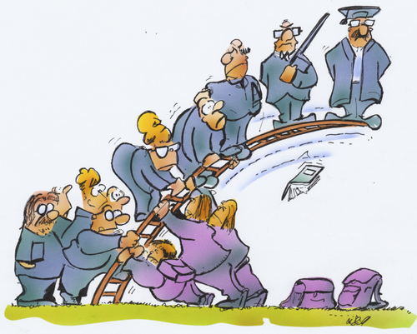
Supporting progression

Slide 9
  Strategic thinking/decision making on progression to HE/jobs
    Tactical alignment of progression partners
    Consider new partnership strategies
    Make decisions/goals based on data
    Allocate resources to achieve planned goals
    Key alliances of progression partnerships
Notes:
11:45-11.48
20

Slide 10

Conclusions
Notes:
12.43
35

Slide 11
Concluding Remarks - Evaluation
What strengths and opportunities identified re.
Journeys to Higher Education? (e.g. Apprenticeships
re. social mobility; FE-HE progression over 5 years;
BME groups in FE; % to FE and % to HEI unchanged)
Learn from data to take forward new strategy
Identify people, resources and tools needed
Deliver key messages for learners and the public
Notes:
12.43 -12.45
36

Slide 12
Recommendations
Further detailed interrogation of data
BIS reports key findings for FECs and HEIs
New partnerships for progression
Funds for further progression research
Enable expansion in learner opportunities
Notes:
37

Slide 13
  References
  Joslin, H., and Smith, S. (2011). Apprentice Progression Tracking Research Project Report. London: University of Greenwich.
  Joslin, H. and Smith, S. (2013). Progression of London College Level 3 Learners to HE. Linking London Research Report.
  Joslin, H., & Smith, S. (2013). The Progression of Apprentices into Higher Education. BIS.
  King, G., Servais, M., Currie, M., Kertoy, M., Law, M., Rosenbaum, P., Specht, J., Willoughby, T., Forchuk, C., & Chalmers, H. (2003). The Community Impacts of Research Oriented Partnerships (The CIROP Measure). Accessed 17 Oct 2011: www.impactmeasure.org

Slide 14
  Jameson, J. (2008) Leadership: Professional communities of leadership practice in post-compulsory education, Stirling University: ESCalate: Discussions in Education Series: HE Subject Centre for Education.
  Jameson, J. and Hillier, Y. (2003) Researching Post-compulsory Education. Research Methods Series. London: Continuum.
  Evans, K. Schoon I and Weale M. (2013) 'Can Lifelong Learning Reshape Life Chances?' British Journal of Educational Studies. 61, 2.
  Francis, B. (2012). Identities and Practices of High Achieving Pupils. London: Continuum.
  Fuller, A., & Unwin, L. (2012) Banging on the Door of the University: The Complexities of Progression from Apprenticeship and other Vocational Programmes in England. SKOPE Monograph No. 14 LLAKES Centre, Institute of Education and the University of Southampton

