Slide 1

Higher Vocational Education in an Age of Uncertainty
Liz Atkins
ESRC HIVE-PED Seminar Series
University of Greenwich
30 September 2016

Slide 2
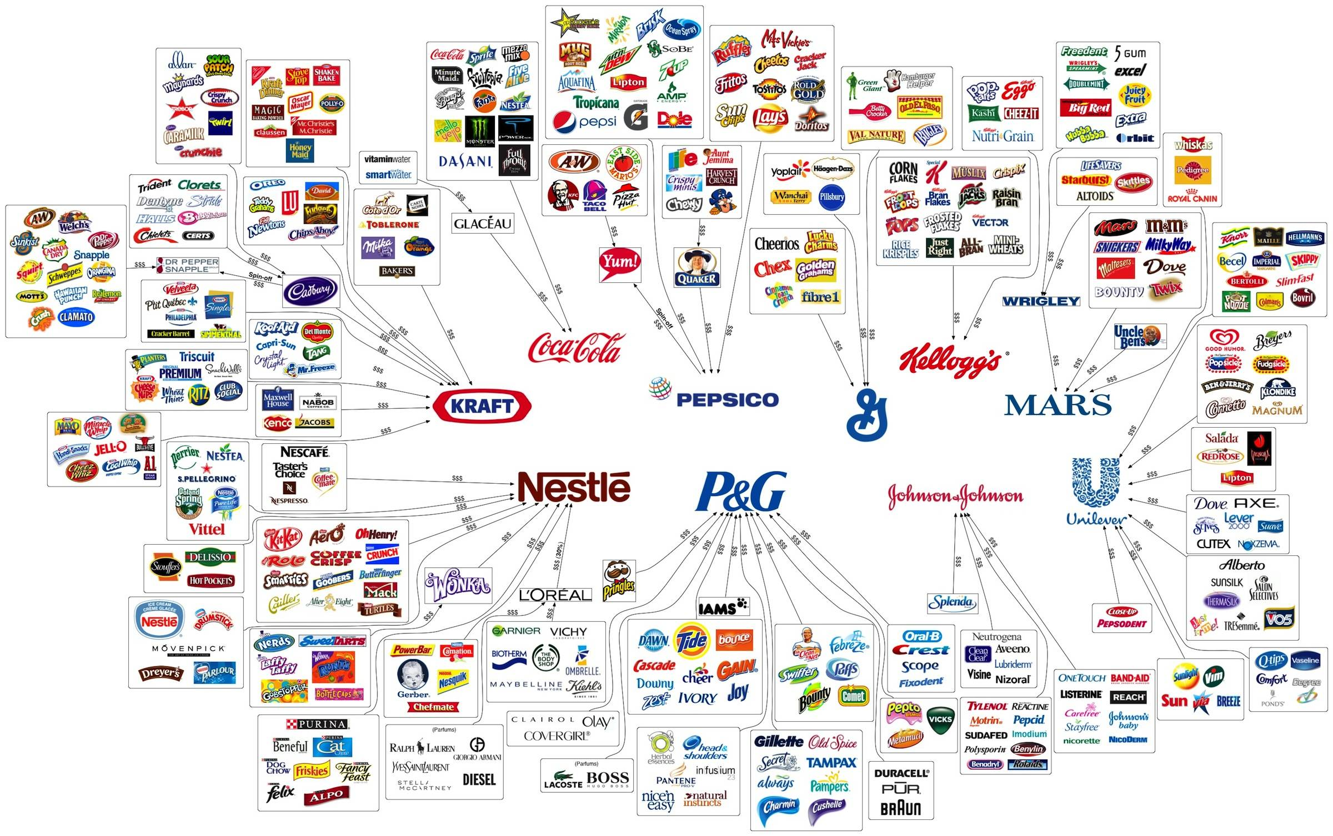

Slide 3
Bauman, 2012
“ ‘Flexibility’ is the slogan of the day, and when applied to the labour market it augurs an end to the ‘job as we know it’, announcing instead the advent of work on short-term contracts, rolling contracts or no contracts, positions with no in-built security but with the ‘until further notice’ clause. Working life is saturated with uncertainty” (p147).
“we live in a world of universal flexibility, under conditions of acute and prospectless Unsichereit [uncertainty], penetrating all aspects of individual life” (p.135).

Slide 4
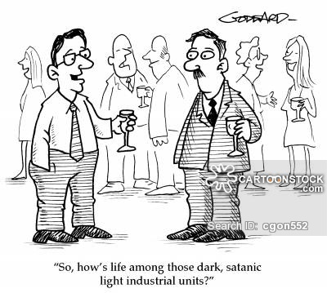
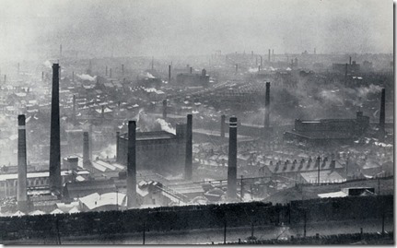
Policy History/Memory
‘It is only the instructed and trained over-looker and artisan that can successfully compete against foreign skills’
(Walker, 2012, drawing on the annual reports of the Yorkshire Union of Mechanics’ Institutes between the 1830s and 1880s)
“Our working age population is less skilled than that of France, Germany, and the US and this contributes to the UK being at least 15% less productive than those countries …we need to increase [skill levels]”
(DBIS, 2011)

Slide 5
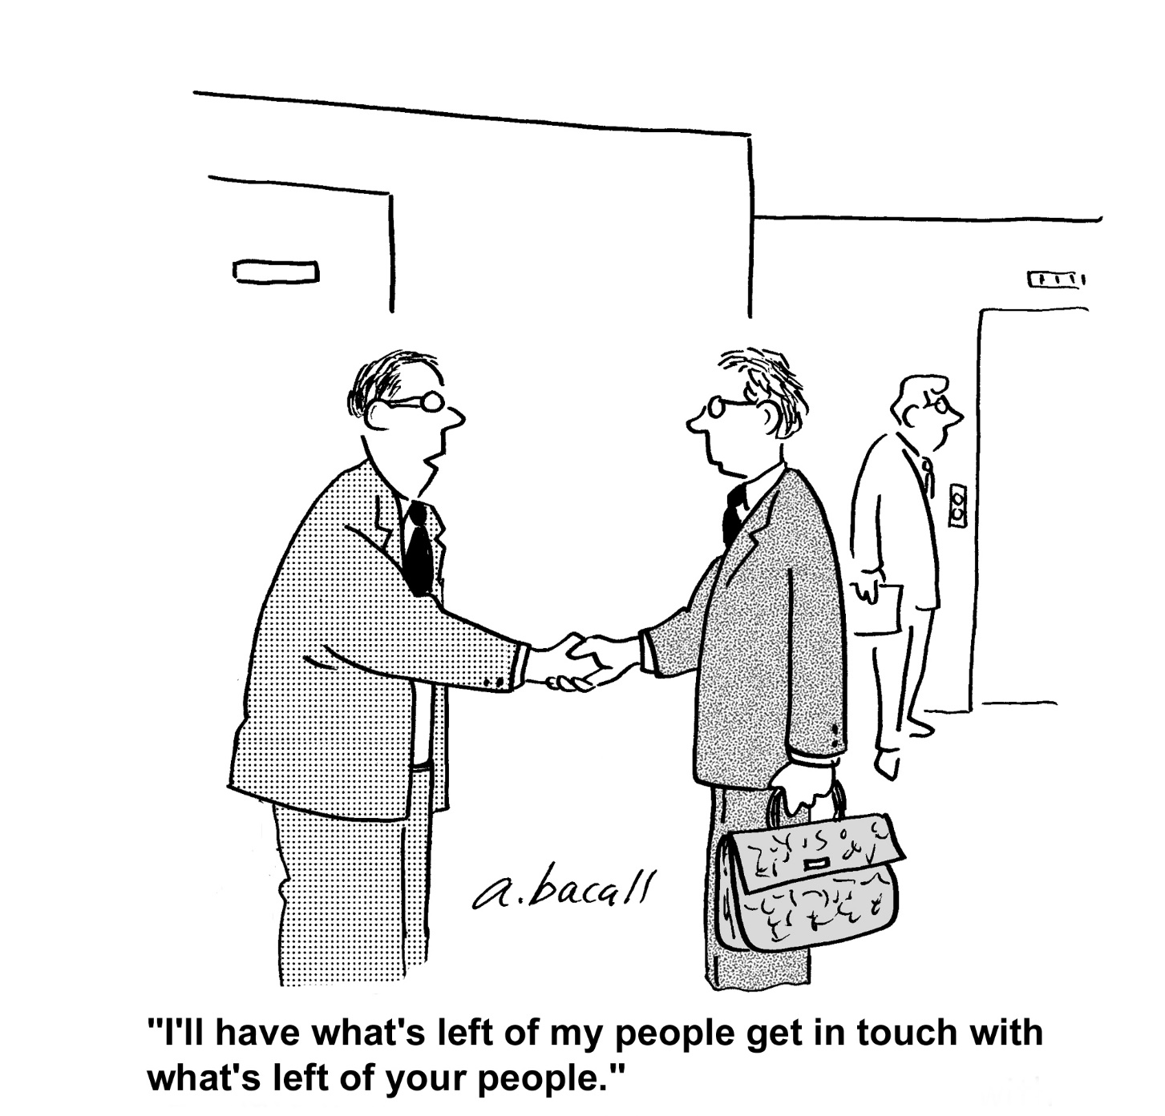
Policy Tensions
Policy Rhetoric Promises
‘
“The technical option will prepare individuals for skilled employment in occupations which require both a substantial body of technical knowledge and a set of practical skills valued by industry”
(DBIS/DoE 2016:17)

Slide 6
Tensions: HIVE Pedagogy
‘High-quality … excellent teaching in realistic simulated work environments … for ‘higher’ technical employment … Nursing Assistant, Child Care Assistant, Teaching Assistant, Administrative Assistant (BIS/DoE 2016)
CBT
De-regulation – ‘trainers’ v. ‘teachers’
Austerity-driven cuts to FE
All roles listed accessible with L3 credentials
‘Higher technical employment’?

Slide 7
Knowledge
Various critiques address the issue of different forms of knowledge having different value in an unequal society. These include work that highlights the lack of meaningful knowledge conferred by the competency based curriculum and assessment employed in vocational education (e.g. see Harris and Hodge, 2009). Other arguments suggest that concepts of knowledge in vocational education are variously:
ill-defined and unclear (Bathmaker, 2013),
Diminished (Ecclestone, 2011)
Of limited exchange value (Keep, 2009).

Slide 8
Uncertainty demands
Critical thinking
Political engagement
Community engagement
Creative, innovative and alternative ways of addressing the challenges of the 21st century
Does HIVE – or what passes for HIVE – offer that?

Slide 9
HIVE offers
Some good, and some poor quality education
Positive rhetoric which masks some of the issues surrounding a narrow instrumental curriculum
A context which is heavily marketized and subject to significant austerity driven cuts
However good HIVE is, is it any more likely to lead the country to global economic domination than any other of the multiple (failed) initiatives since Callaghan's 1976 Ruskin speech?

Slide 10
Tensions and Disconnects
There is a disconnect between what pedagogy does and HIVE actually offers, and what the government expects, and what is possible in a globalised economy where competitive = cheap
Notes:
.

Slide 11
Policy memory
‘It is only the instructed and trained over-looker and artisan that can successfully compete against foreign skills’
“Our working age population is less skilled than that of France, Germany, and the US and this contributes to the UK being at least 15% less productive than those countries …we need to increase [skill levels]
“They knew of no other way of thinking or doing” (Martin Jacques, 2016)

Slide 12
Because they knew no other way
We will see in HIVE more continuities than discontinuities from earlier policy
Remains classed and gendered
HIVE is merely one aspect of a wider system which remains deeply narrow, divided and divisive (McCulloch, 1987; Tomlinson, 1997; Atkins, 2016) and which is complicit in class and labour (re) production. This analysis suggest that initiatives ‘tinkering’ with HIVE alone will not address the emerging issues around policy and pedagogy –wider social and educational issues need addressing

Slide 13
Finally
On a more optimistic note, it seems possible that neo-liberal policy will run its course, facing opposition from a number of different social movements which express opposition to neo-liberalism and globalisation. These diverse movements holding slightly divergent politics may challenge the hegemony of neo-liberalism. Movements such as Occupy, anti-war coalitions and environmental groups, may question current neoliberal policy. Mass migration of economic and political refugees, both within and beyond Europe may also serve to problematise the tenets of competitiveness, marketization and commodification. Whilst none of these individually will change the perceived demands for competition and economic success on which VET policy is predicated, but taken together, could contribute to wider social and economic change. (Avis and Atkins, in press, 2017)

Slide 14
References
Atkins, L. (2016) The Odyssey: School to Work Transitions, Serendipity and Position in the Field British Journal of Sociology of Education
Avis, James & Atkins, Liz (in press, 2017) Youth Transitions, VET and the ‘Making’ of Class: Changing theorisations for changing times? Research in Post-compulsory Education 22 (2) or 22 (3)
Bathmaker, A-M. 2013. “Defining ‘knowledge’ in vocational education qualifications in England: an analysis of key stakeholders, and their constructions of knowledge, purposes and content.” Journal of Vocational Education and Training. 65, (1): 87-107 doi:10.1080/13636820.2012.755210
Bauman, Z. (2012) Liquid Modernity 2nd edition Cambridge: Polity Press
Callaghan, J. (1976) Towards a National Debate speech given at Ruskin College, Oxford October 18 1976. At https://www.theguardian.com/education/thegreatdebate/story/0,9860,574645,00.html accessed 23.09.2016
DBIS (2011) Skills for Sustainable Growth
DBIS/DoE (2016) Post-16 Skills Plan CM9280 HMSO
Ecclestone, K. 2011. “Emotionally‐vulnerable subjects and new inequalities: the educational implications of an ‘epistemology of the emotions’.” International Studies in Sociology of Education. 21(2): 91-113. doi:10.1080/09620214.2011.575100
Harris, R. and S. Hodge. 2009. “A Quarter of a century of competency-based training: The vicissitudes of an idea.” International Journal of Training Research. 7, (2): p. 122-133. doi: 10.5172/ijtr.7.2.122
Jacques, Martin (2016) The death of neoliberalism and the crisis in western politics, The Guardian, 21.08.2016. At https://www.theguardian.com/commentisfree/2016/aug/21/death-of-neoliberalism-crisis-in-western-politics accessed 23.09.2016
Keep, Ewart. 2009. Internal and External Incentives to Engage in Education and Training – a Framework for Analysing the Forces Acting on Individuals? Monograph No. 12 ESRC Centre on Skills, Knowledge & Organisational Performance, Cardiff University. Online at: http://www.cardiff.ac.uk/socsi/research/researchcentres/skope/publications/monographs/index.html
McCulloch, G. (1987) ‘History and Policy: The Politics of TVEI’ in Gleeson, D. (ed) TVEI and Secondary Education: a critical appraisal Milton Keynes: Open University Press
Tomlinson, S. (1997). ‘Education 14-19: Divided and Divisive’ in S. Tomlinson (ed) Education 14-19: Critical Perspectives. London: Athlone Press.
Walker, M (2012) ‘It is only the instructed and trained overlooker and artisan that can successfully compete against foreign skills’: Nineteenth-century adult technical and vocational education offered by the Yorkshire Union of Mechanics’ Institutes and the foundation of further education curricula Journal of Adult and Continuing Education 18: 2, 61-79, Doi: 10.7227/JACE.18.2.5

